Slide 1
CAS: AI and Creative Practices
Module 6:
AI for Natural Language

Slide 2
Monday & Tuesday
1 Refresh: Transformers & LLMs
2 Trips to Open Source
3 The System Message
4 Small & Local LLMs
5 Rules & Nonsense

Slide 3
Orchestrating Real-Time HMI
(Going to the theatre)
Till Müller-Klug; INTEROBANG, BERLIN

Slide 4
Wednesday Afternoon
Artistic Starting Points
Hopes & Fears Bar

Slide 5
Thursday
The Answering Machine
From LLMs to Agents
Designing an Agent

Slide 6
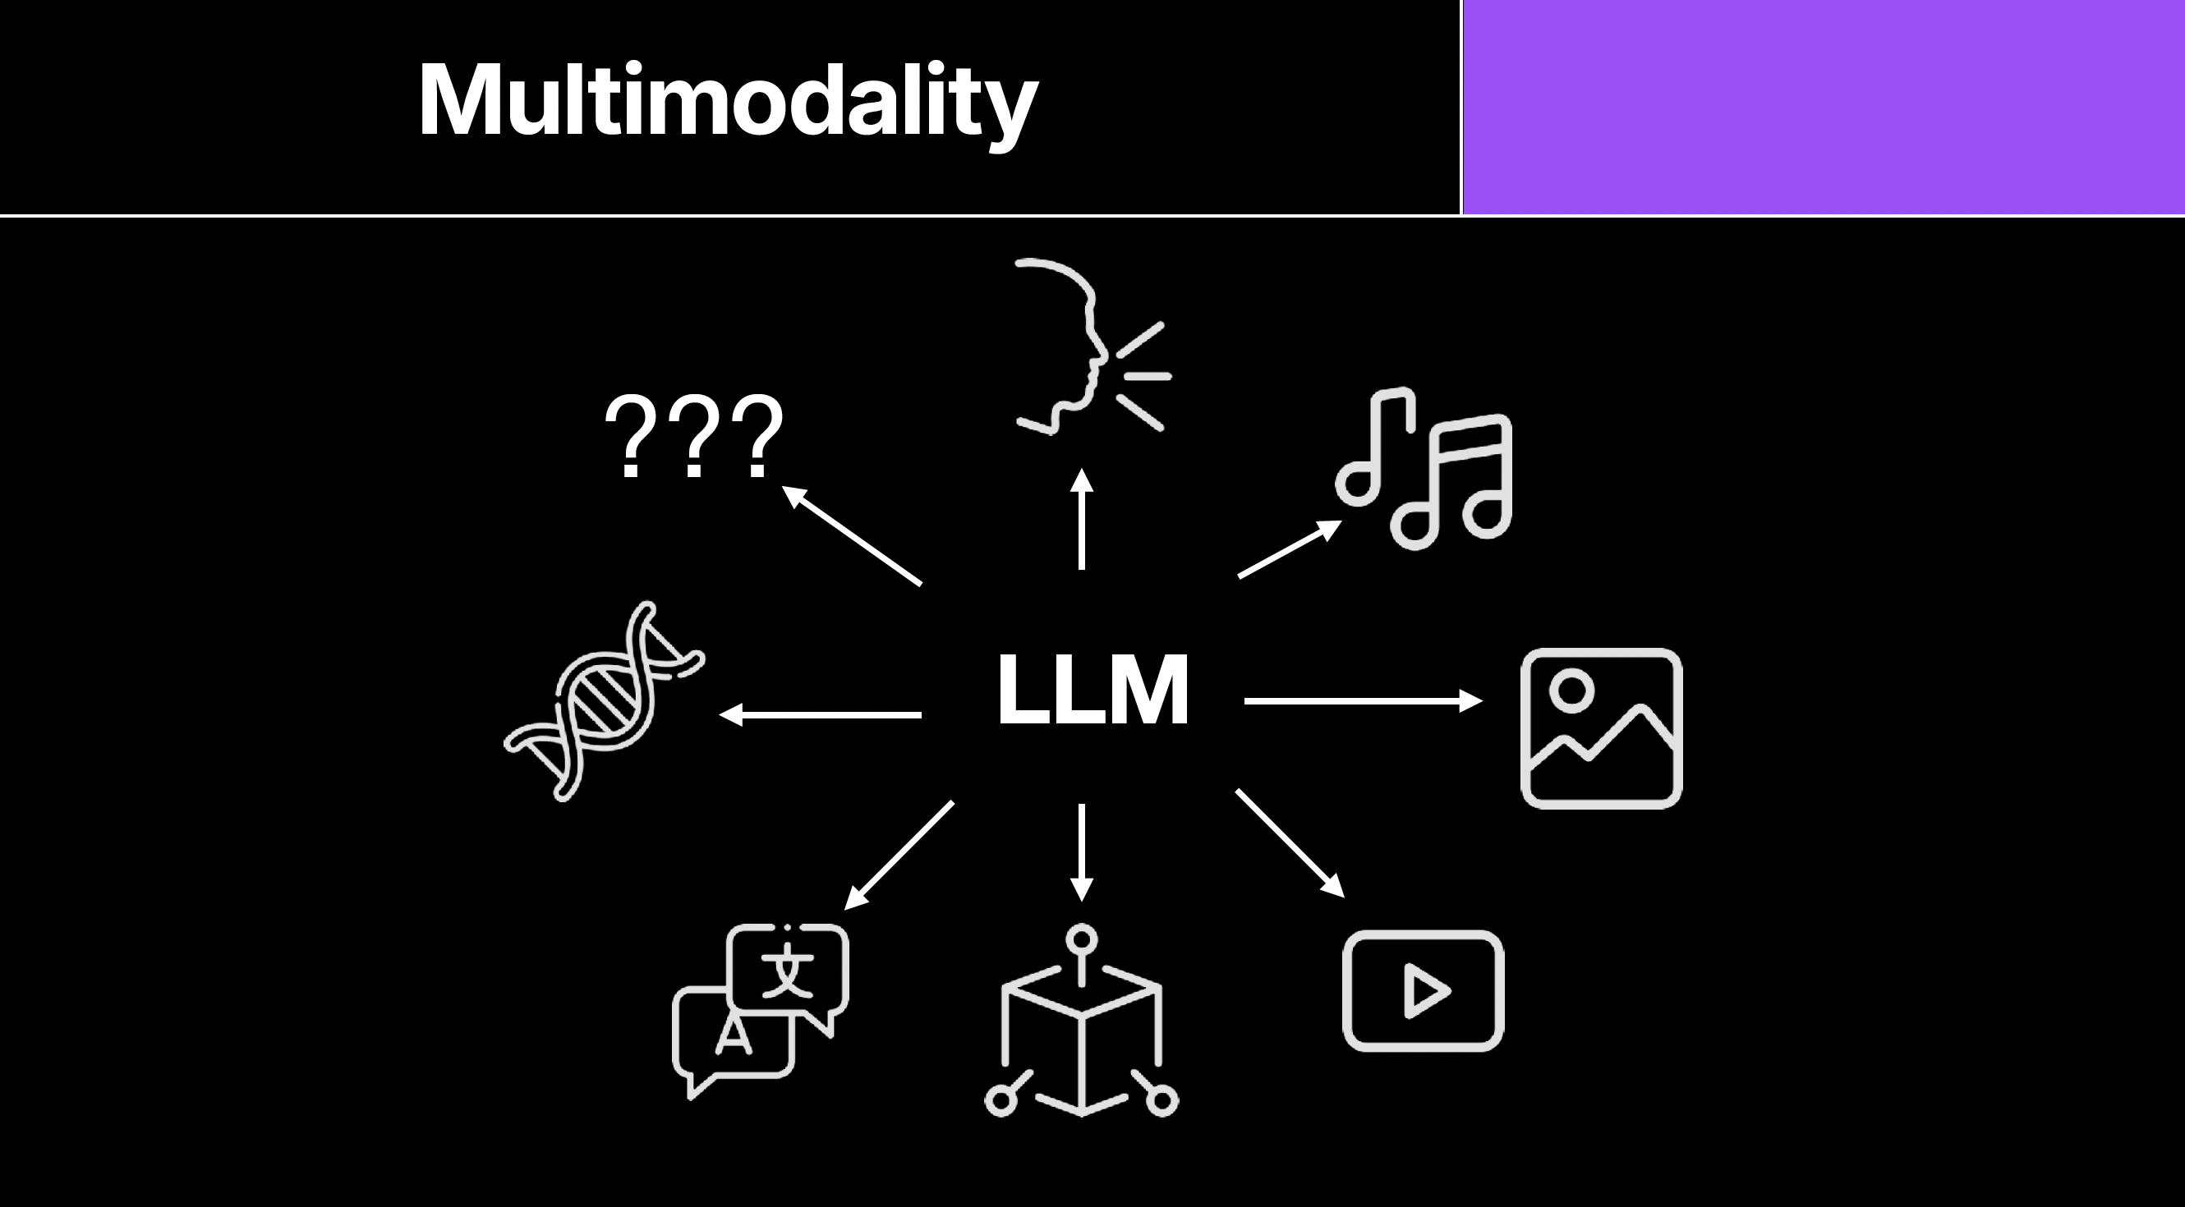
Guilaume Witz

Slide 7
JEDa Models
JEDa = Joint Embedding–Decision Architecture
Guilaume Witz

Slide 8
What are LLMs?
What are Transformers ?
Guilaume Witz

Slide 9
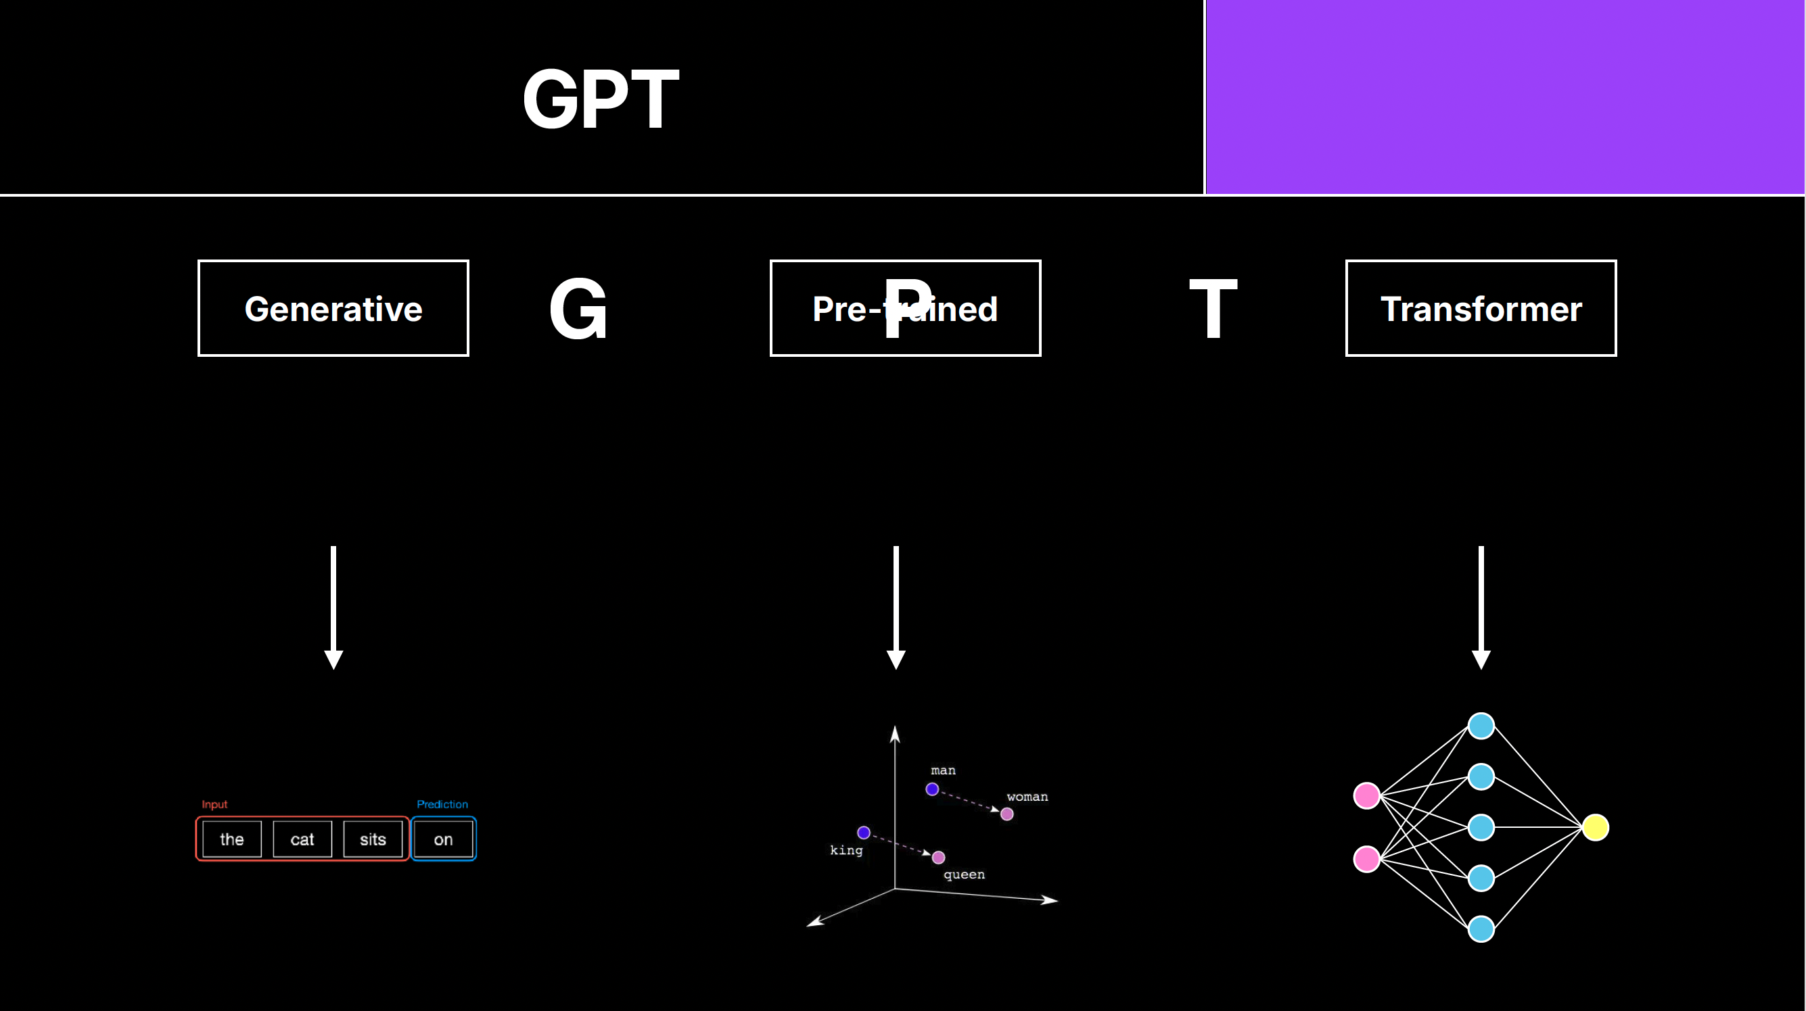
Guilaume Witz

Slide 10
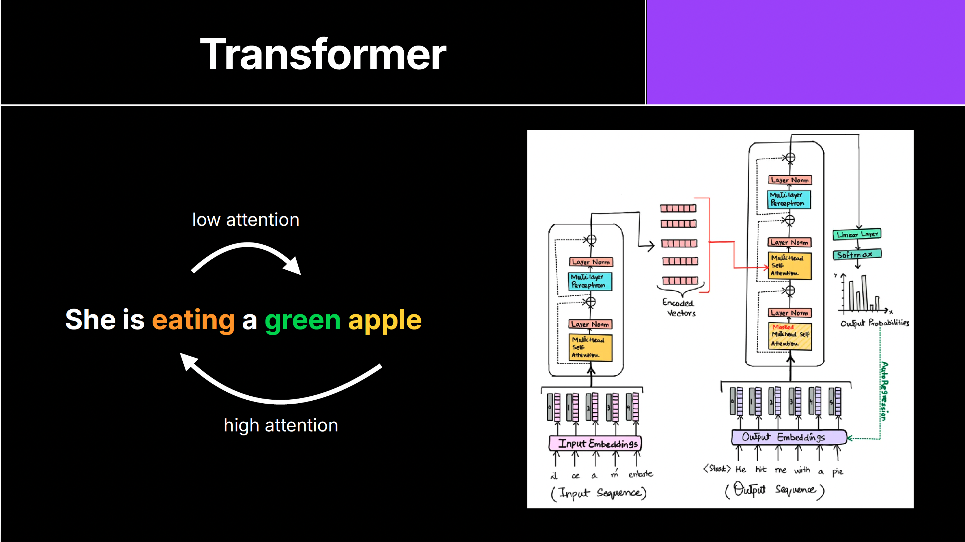

Slide 11
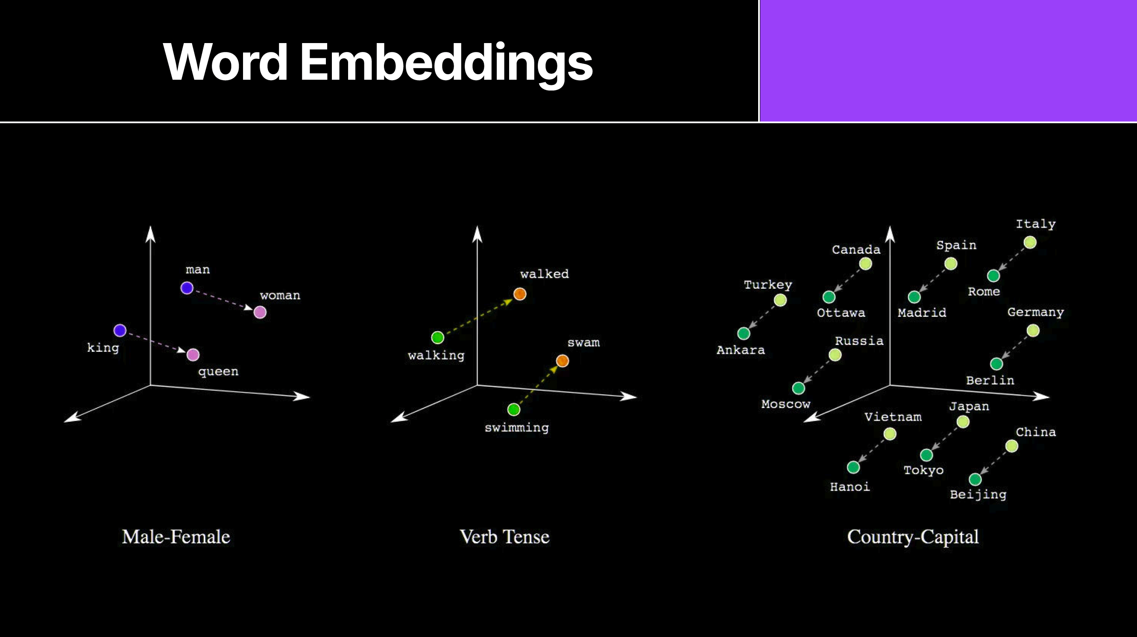
Guilaume Witz

Slide 12
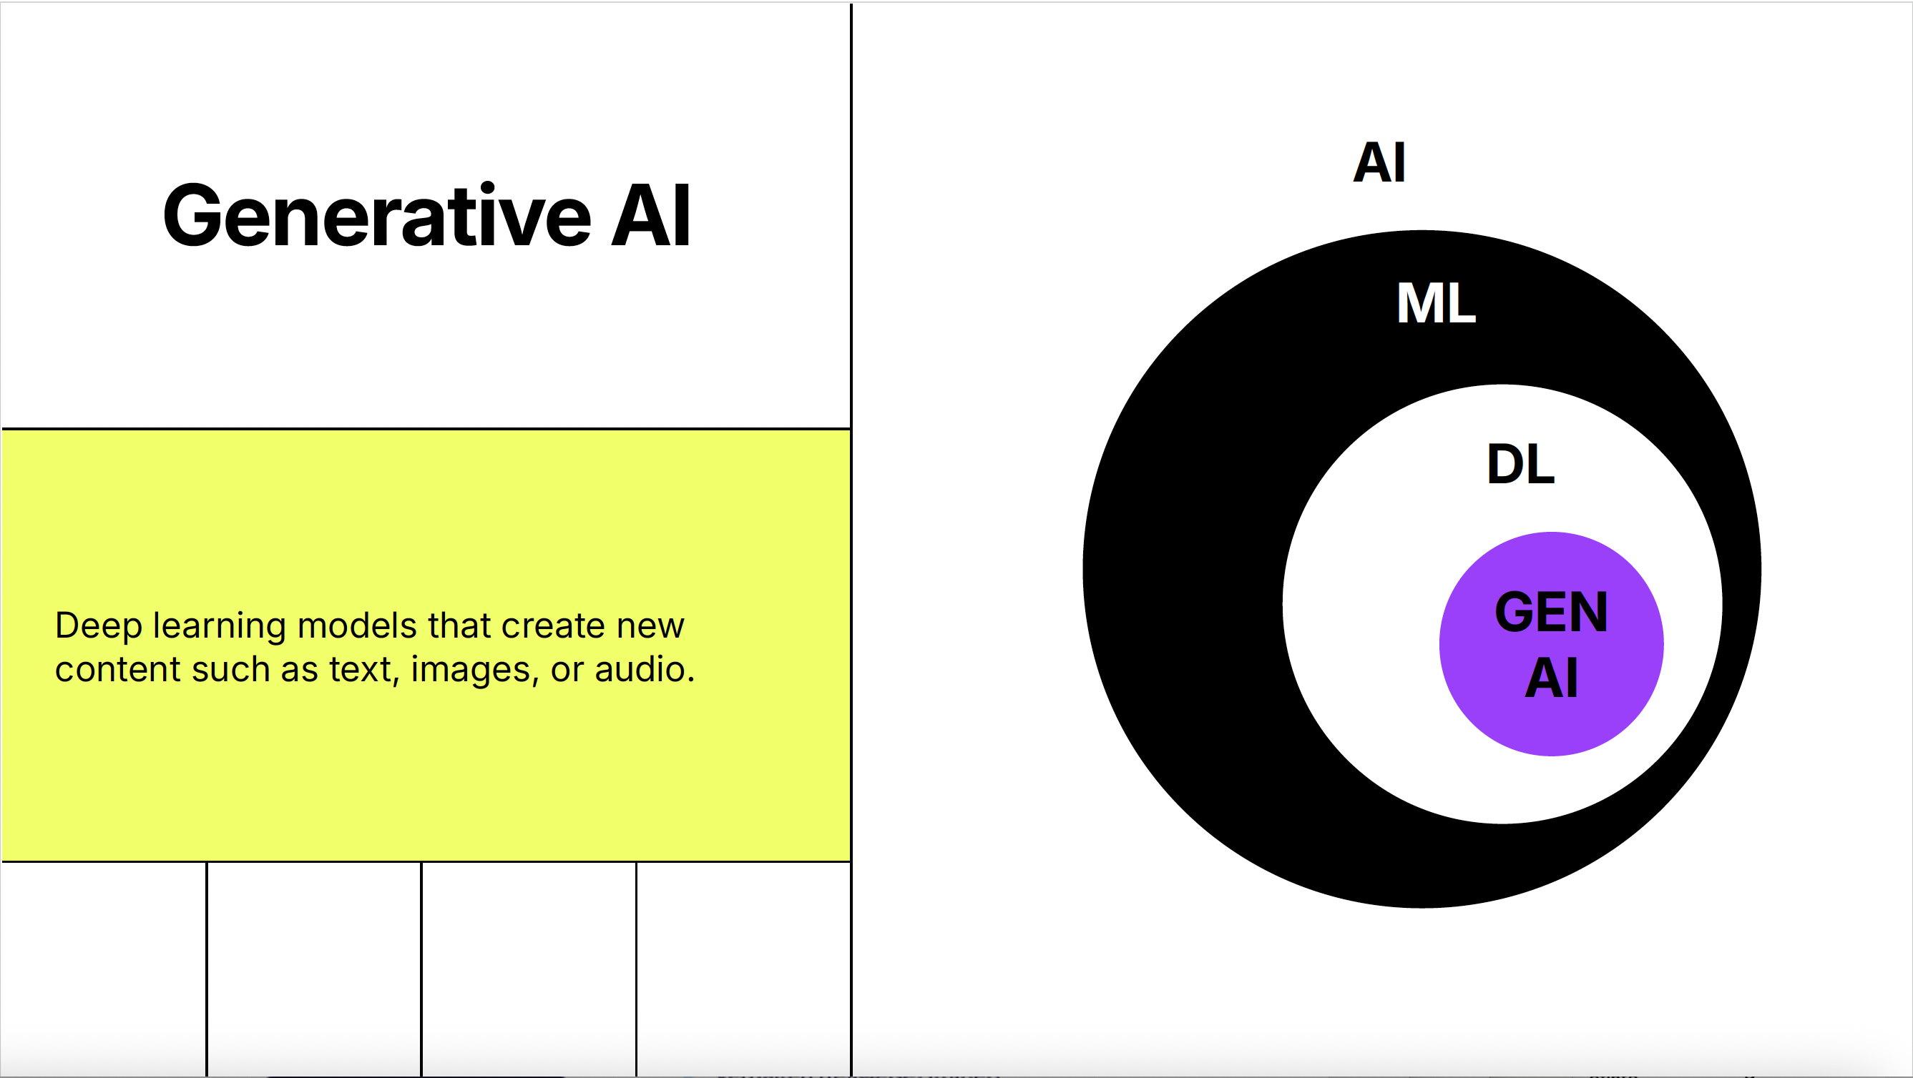
Guilaume Witz

Slide 13
AI
Machine Learning
Deep Learning
GenAI

Slide 14
AI
Machine Learning
Deep Learning
GenAI
Tranformer Models & Diffusion Models

Slide 15
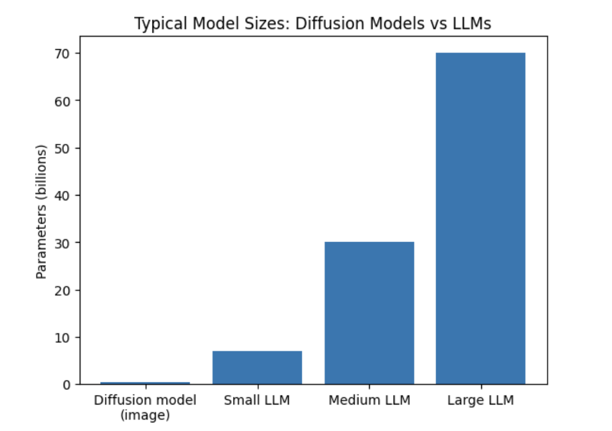

Slide 16
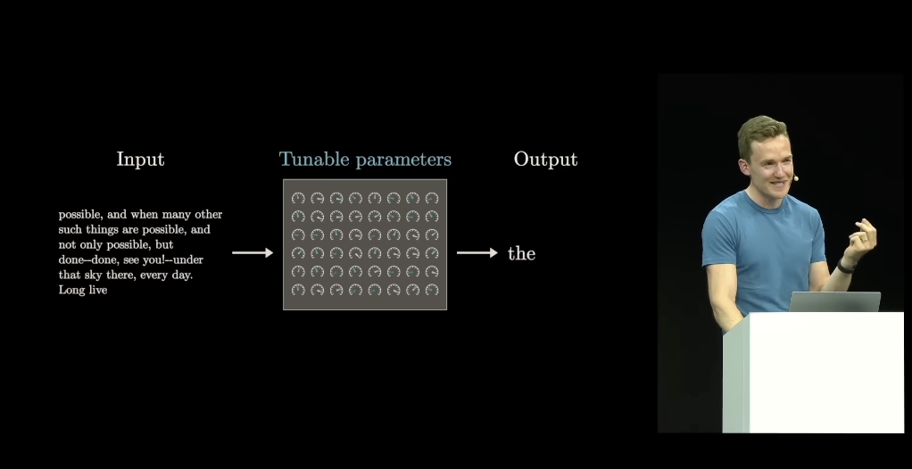
Watch Video
„Transformeres, the tech behind LLMs“
3blue1brown
(30 Min)
https://www.youtube.com/watch?v=wjZofJX0v4M
Guilaume Witz

Slide 17
Do transformers understand meaning?

Slide 18
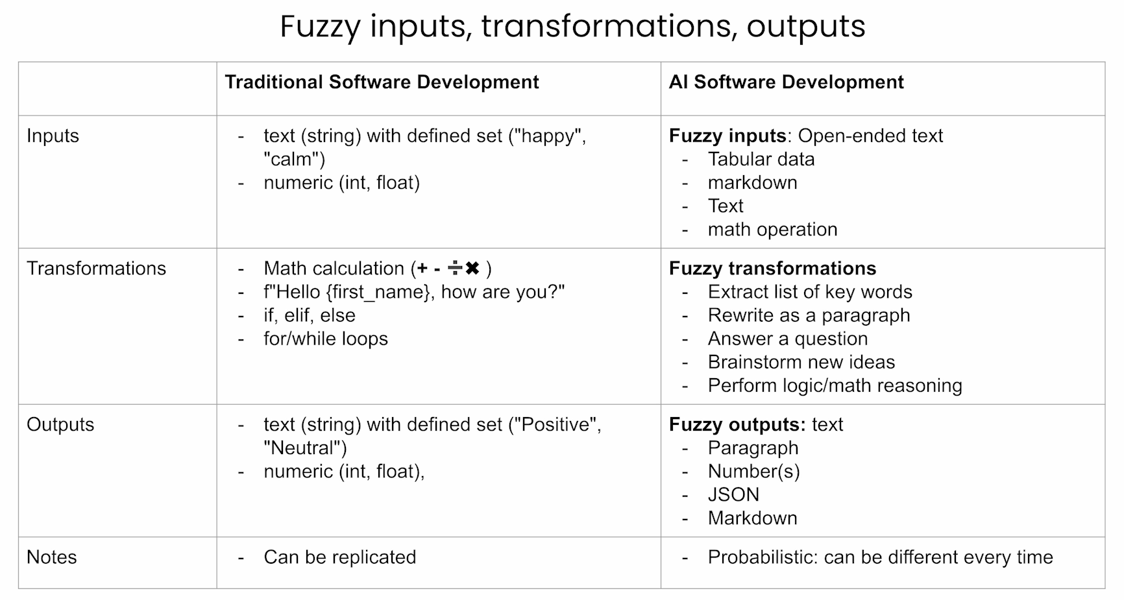

Slide 19
Prompt Design
Fine-Tuning
Instructmodel
Basemodel

Slide 20
Prompt Design | Takes little compute, little know-how, some experimentation | Anyone with interest and time
Fine Tuning | Takes compute, experts | Players with experts
Instruct Model | Takes a lot of compute, money, experts and click workers | Big Tech Companies, Universities
Base Model | Takes a lot of compute, money and experts | Big Tech Companies, Universities

Slide 21
RAG = Retrievel Augmented Generation
Lets you define the knowledge base of the bot
Creates embeddings of your input text

Slide 22
Groups of 3:
“Should I train a model myself?
Should I run the model locally?
Should I learn to fine-tune?
Will RAG help me achieve my goals?
Is prompting enough for my use case?
How deep will I go?”

Slide 23
Proprietary Models Open Weight Models Open Source Models

Slide 24
Trips to Open Source
https://huggingface.co

Slide 25


Slide 26
License Type | Typical Feature | Relevant for You?
Permissive (e.g., Apache 2.0, MIT) | Very permissive: commercially usable, modifiable, few obligations | Yes — maximally flexible. For example, Apache 2.0. Mend.io+1
Copyleft (e.g., GPL family) | Usable, but modifications or redistribution must follow the same conditions | Caution: re-licensing may be required
Non-commercial / “NC” | Use permitted only for non-commercial purposes | In research/theatre contexts: check whether “commercial” includes stage work
“No derivatives” / ND | Modification and derivatives not allowed at all | Restrictive: hardly adaptable
“Responsible AI,” RAIL, special licenses | Additional conditions such as exclusion of certain use cases | Very relevant if you use the model publicly or interactively. Mend.io+1

Slide 27
Apps, Inference Provider, Local Models
Groq
Ollama
LM Studio

Slide 28
The System Message

Slide 29
Creating a Virtual Persona
Character AI
ChatGPT

Slide 30
Exercise 1:
Go to Character.ai
Register

Slide 31
✅ Step-by-step: How to sign up
Go to the official Character.ai website.
Click “Sign Up” (often at the top right on the homepage).
Choose a registration method — options include: “Continue with Google”, “Continue with Apple”, or sign up with an email address.
If using email, enter your email address (and optionally a chosen username). After submitting, you will be sent a verification email. Open that email and click the confirmation link to activate your account.
Provide your birthday: note that for users in the EU / EEA (so including Switzerland), the minimum age is 16.
Once email is verified (or Google / Apple login used), your account is created — you can then log in and start using Character.ai

Slide 32
Exercise 1:
Go to Character.ai
Register
Look around
Find a partner
Create a character together

Slide 33
Exercise 1:
Go to Character.ai
Register
Look around
Find a partner
Create a character together
Plan how to test your bot
Test your bot

Slide 34
The Charm of primitive Tools

Slide 35
The Charm of primitive Tools
Cleverbot with Cleverbot
https://www.youtube.com/watch?time_continue=4&v=WnzlbyTZsQY

Slide 36
Local LLMs

Slide 37
Exercise 2:
Download LM Studio

Slide 38
Exercise 2:
Download LM Studio
Choose a small model (<4b)

Slide 39
Exercise 2:
Download LM Studio
Choose a small model (<4b)
Play around with the systemmessage and the parameters

Slide 40
Exercise 2:
Download LM Studio
Choose a small model (<4b)
Play around with the systemmessage and the parameters
Choose a VLM with RAG

Slide 41
Exercise 2:
Download LM Studio
Choose a small model (<4b)
Play around with the systemmessage and the parameters
Choose a VLM with RAG
Play around with Image-to-text and RAG

Slide 42
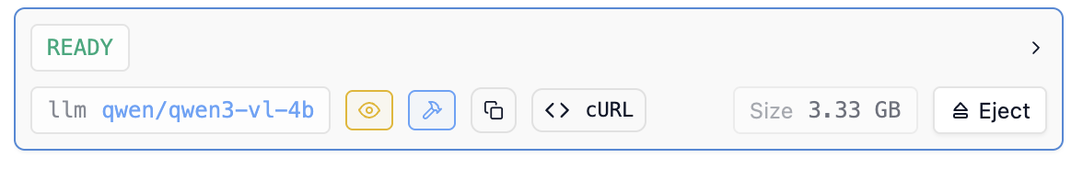
For example this model

